Slide 1
LAB LECTURE 4
LC: Ms. Shiza Riaz Memon

Slide 2
STEGANOGRAPHY
Steganography involves hiding sensitive information within an ordinary, non-secret file or message, so that it will not be detected.
The sensitive information will then be extracted from the ordinary file or message at its destination, thus avoiding detection.
Steganography is an additional step that can be used in conjunction with encryption in order to conceal or protect data.
You can use steganography to hide text, video, images, or even audio data.
Steganalysis is the study of detecting messages hidden using steganography performed by Steganalyst

Slide 3
Types of Steganography
1. Text Steganography − There is steganography in text files, which entails secretly storing information. In this method, the hidden data is encoded into the letter of each word.
2. Image Steganography − The second type of steganography is image steganography, which entails concealing data by using an image of a different object as a cover. Pixel intensities are the key to data concealment in image steganography.
3. Audio Steganography − It is the science of hiding data in sound. Used digitally, it protects against unauthorized reproduction. Watermarking is a technique that encrypts one piece of data (the message) within another (the "carrier"). Its typical uses involve media playback, primarily audio clips.

Slide 4
Types of Steganography
4. Video Steganography − Video steganography is a method of secretly embedding data or other files within a video file on a computer. Video (a collection of still images) can function as the "carrier" in this scheme. Discrete cosine transform (DCT) is commonly used to insert values that can be used to hide the data in each image in the video, which is undetectable to the naked eye. Video steganography typically employs the following file formats: H.264, MP4, MPEG, and AVI.
5. Network or Protocol Steganography − It involves concealing data by using a network protocol like TCP, UDP, ICMP, IP, etc., as a cover object. Steganography can be used in the case of covert channels, which occur in the OSI layer network model.

Slide 5
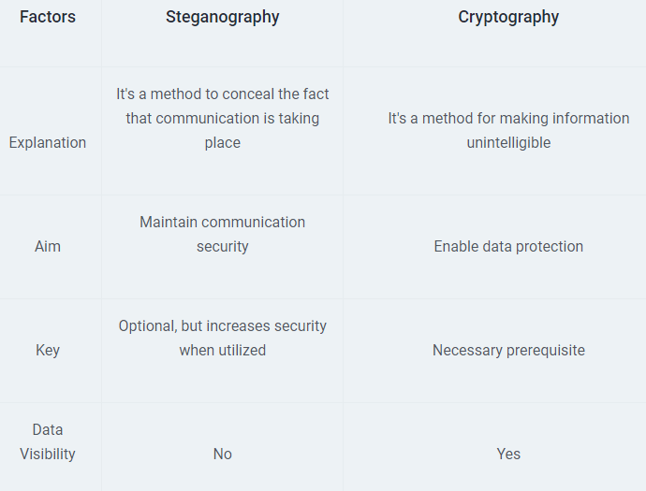
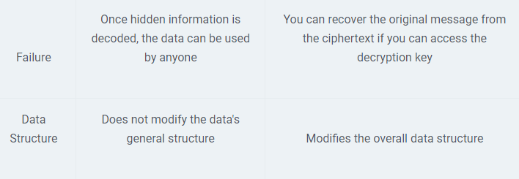

Slide 6
Steganography Techniques
Secure Cover Selection: Secure Cover Selection involves finding the correct block image to carry malware. Then, hackers compare their chosen image medium with the malware blocks. If an image block matches the malware, the hackers fit it into the carrier image, creating an identical image infected with the malware. This image subsequently passes quickly through threat detection methods.
Least Significant Bit: That phrase almost sounds like a put-down, doesn’t it? However, in this case, it refers to pixels. Grayscale image pixels are broken into eight bits, and the last bit, the eighth one, is called the Least Significant Bit. Hackers use this bit to embed malicious code because the overall pixel value will be reduced by only one, and the human eye can’t detect the difference in the image. So, no one is even aware that anything is amiss, and that the image is carrying something dangerous within.
Palette-Based Technique: Like the Least Significant Bit technique, the Palette-Based Technique also relies on images. Hackers embed their message in palette-based images such as GIF files, making it difficult for cyber security threat hunters or ethical hackers to detect the attack.

Slide 7
Steganography Tools
Steghide: Steghide is a free tool that uses steganography to conceal information in other files, such as media or text.
Stegosuite: It is a Java-based, free steganography tool. Stegosuite makes it simple to obfuscate data in pictures for covert purposes.
OpenPuff: It is a high-quality steganographic tool that allows you to conceal data in other media types like images, videos, and Flash animations.
Xiao Steganography: To conceal information in BMP images or WAV files, use the free Xiao Steganography tool.
SSuite Picsel: The free portable program SSuite Picsel is yet another option for hiding text within an image file; however, it uses a somewhat different method than other programs

